Slide 1
Chapter 9: Performance
An ounce of performance is worth pounds of promises.
—Mae West

Slide 2
Chapter Outline
What is Performance?
Performance General Scenario
Tactics for Performance
Tactics-Based Questionnaire for Performance
Patterns for Performance
Summary

Slide 3
What is Performance?
Performance is about time and the software system’s ability to meet timing requirements.
When events occur – interrupts, messages, requests from users or other systems, or clock events marking the passage of time – the system, or some element of the system, must respond to them in time.
Characterizing the events that can occur (and when they can occur) and the system or element’s time-based response to those events is the essence is discussing performance.

Slide 4
What is Performance?
All systems have performance requirements, even if they are not expressed.
Performance is often linked to scalability—that is, increasing your system’s capacity for work, while still performing well.
Often, performance improvement happens after you have constructed a version of your system and found its performance to be inadequate. You can anticipate this by architecting your system with performance in mind.

Slide 5
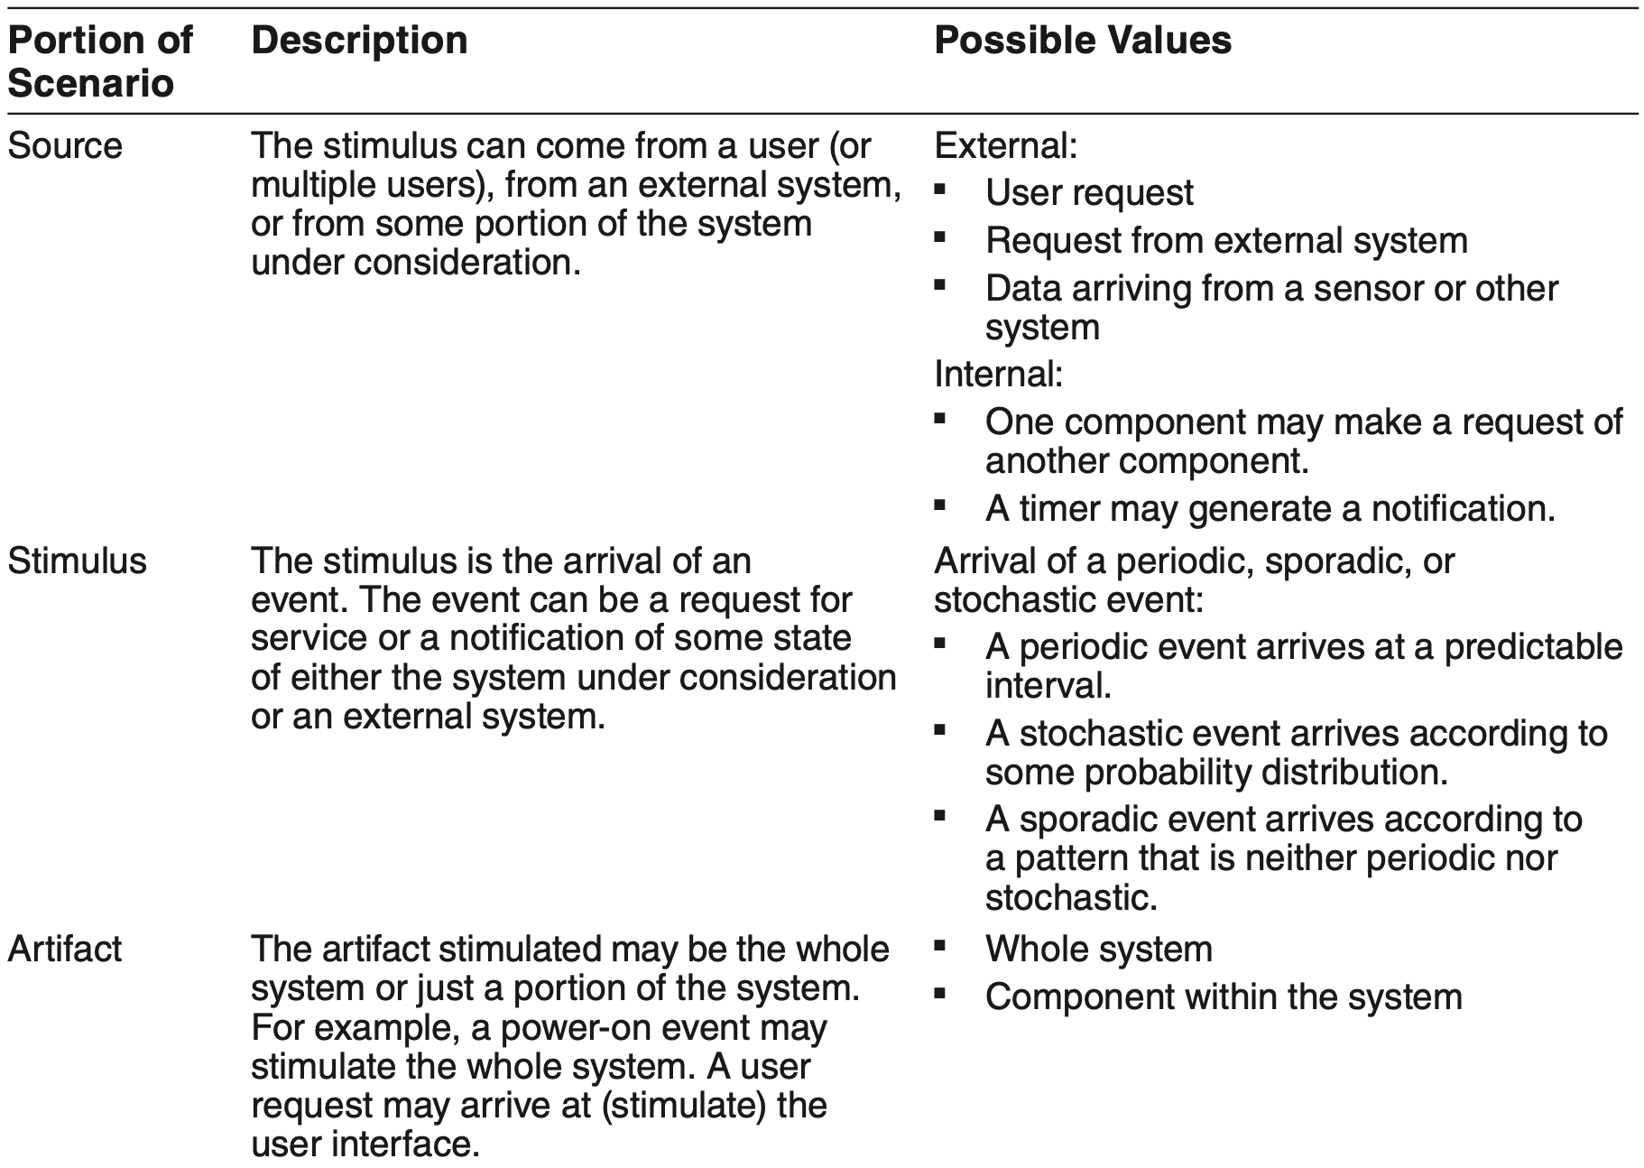
Performance General Scenario

Slide 6
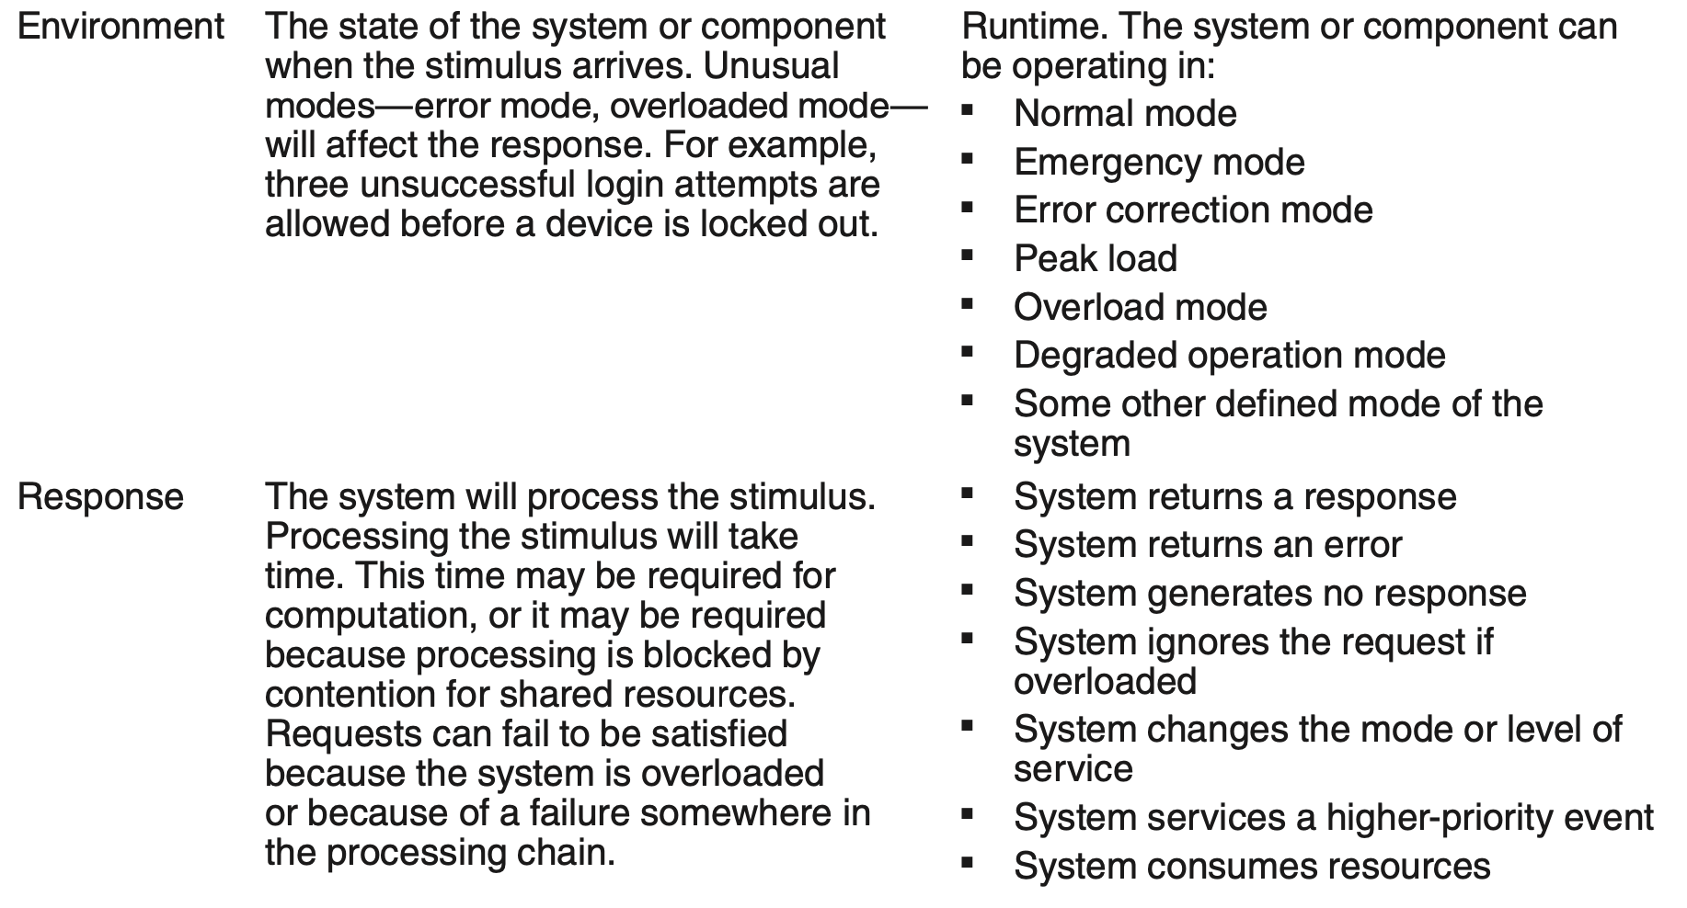
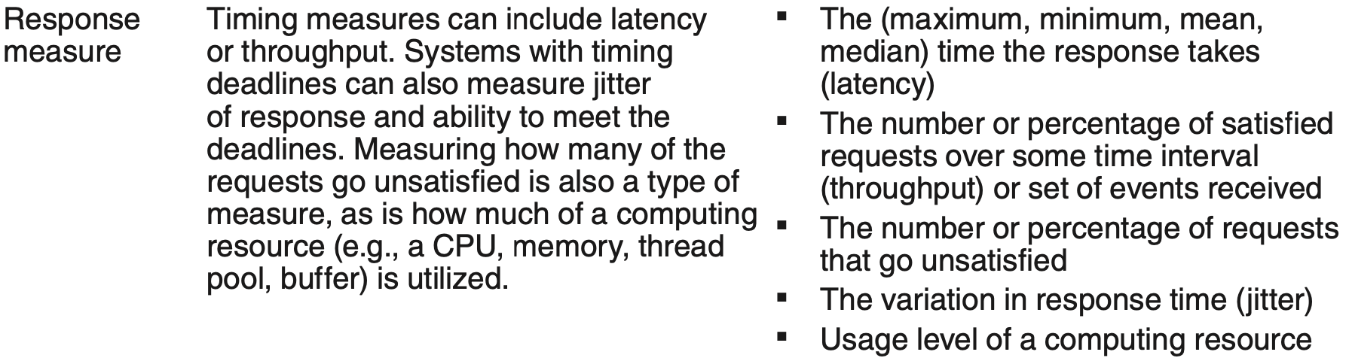
Performance General Scenario

Slide 7
Sample Concrete Performance Scenario
Five hundred users initiate 2,000 requests in a 30-second interval, under normal operations. The system processes all of the requests with an average latency of two seconds.

Slide 8
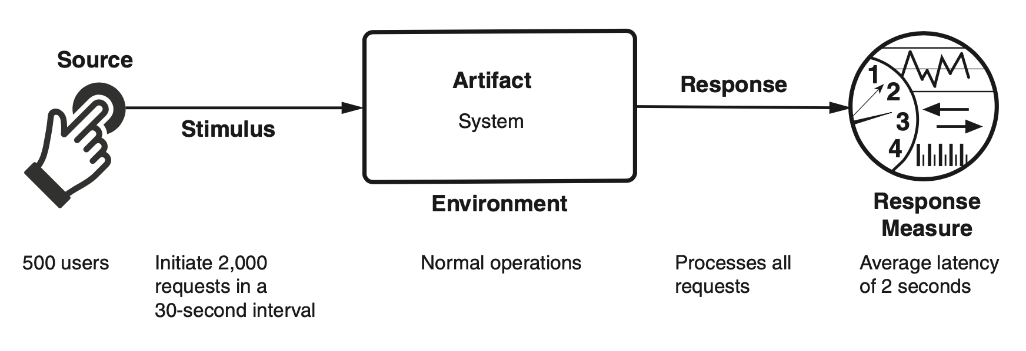
Sample Concrete Performance Scenario

Slide 9
Goal of Performance Tactics
The goal of performance tactics is to generate a response to events arriving at the system under some time-based or resource-based constraint.
The event can be a single event or a stream, and is the trigger to perform computation.
Performance tactics control the time or resources used to generate a response.

Slide 10
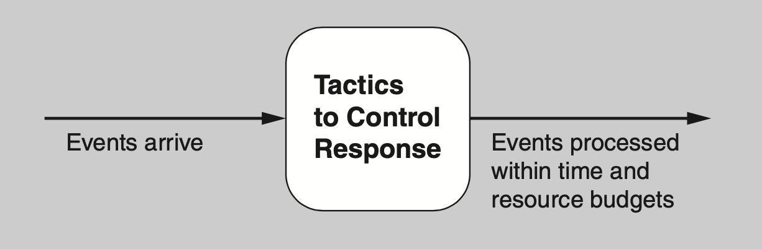
Goal of Performance Tactics

Slide 11
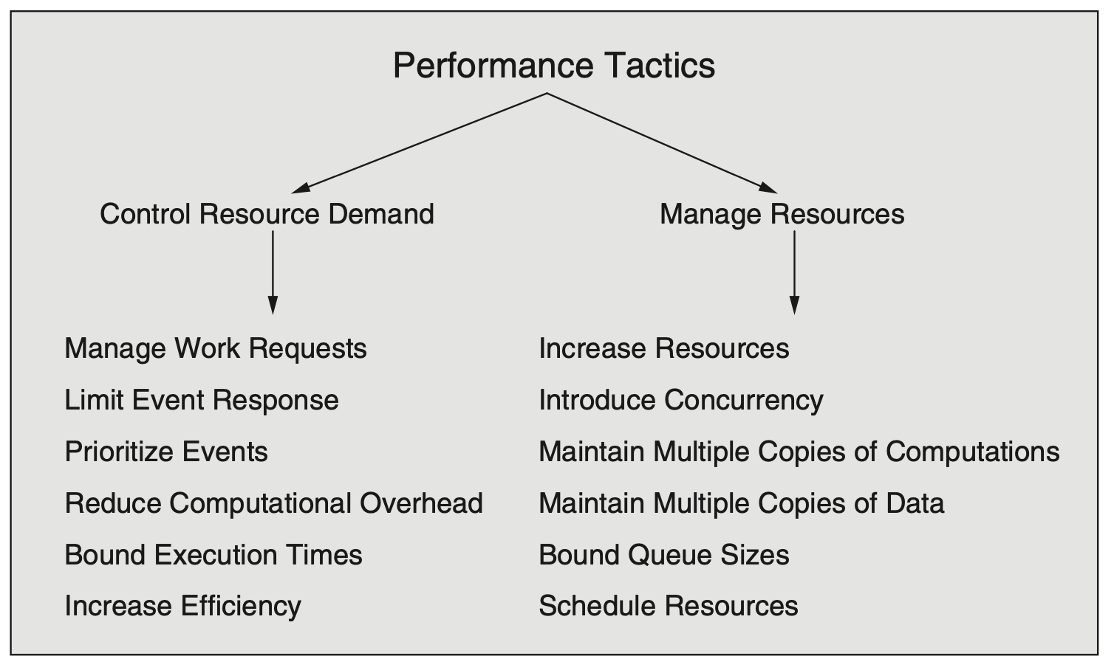
Performance Tactics

Slide 12
Control Resource Demand
Manage work requests. One way to reduce work is to reduce the number of requests coming into the system to do work. Ways to do that include:
Manage event arrival
Manage sampling rate
Limit event response. When events arrive too rapidly to be processed, they must be queued until they can be processed, or they are discarded. You may choose to process events only up to a set maximum rate, thereby ensuring predictable processing for other events. This tactic could be triggered by a queue size or processor utilization exceeding a warning level. Or it could be triggered by an event rate that violates an SLA.
Prioritize events. If not all events are equally important, you can impose a priority scheme that ranks events according to how important it is to service them. If insufficient resources are available to service them when they arise, low-priority events might be ignored.

Slide 13
Control Resource Demand
Reduce computational overhead. For events that do make it into the system, the following approaches can be implemented to reduce the amount of work involved in handling each event:
Reduce indirection
Co-locate communicating resources
Periodic cleaning
Bound execution times. You can place a limit on how much execution time is used to respond to an event.
Increase efficiency of resource usage. Improving the efficiency of algorithms used in critical areas can decrease latency and improve throughput and resource consumption.

Slide 14
Manage Resources
Increase resources. Faster processors, additional processors, additional memory, and faster networks all have the potential to improve performance. Cost is usually a consideration in the choice of resources, but increasing the resources is, in many cases, the cheapest way to get immediate improvement.
Introduce concurrency. If requests can be processed in parallel, blocked time can be reduced. Concurrency can be introduced by processing different streams of events on different threads or by creating additional threads to process different sets of activities.
Maintain multiple copies of computations. This tactic reduces the contention that would occur if all requests for service were allocated to a single instance.

Slide 15
Manage Resources
Maintain multiple copies of data. Two common examples of maintaining multiple copies of data are data replication and caching. Data replication involves keeping separate copies of the data to reduce contention. Caching also involves keeping copies of data (with one set of data possibly being a subset of the other), but on storage with different access speeds.
Bound queue sizes. This tactic controls the maximum number of queued arrivals and consequently the resources used to process the arrivals. If you adopt this tactic, you need to establish a policy for what happens when the queues overflow and decide if not responding to lost events is acceptable.
Schedule resources. Whenever contention for a resource occurs, the resource must be scheduled. Processors are scheduled, buffers are scheduled, and networks are scheduled. Your concern as an architect is to understand the characteristics of each resource’s use and choose the scheduling strategy that is compatible with it.

Slide 16
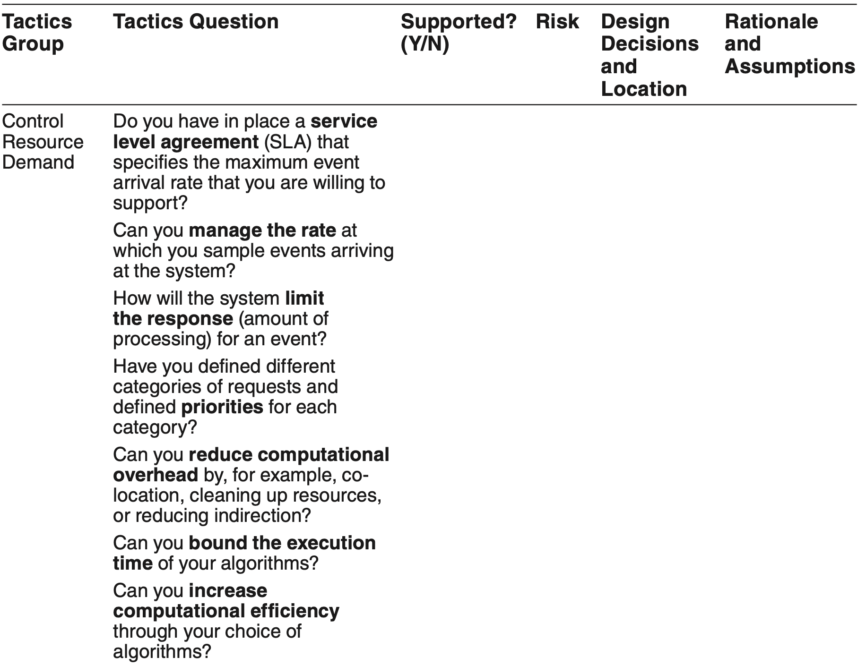
Tactics-Based Questionnaire for Performance

Slide 17
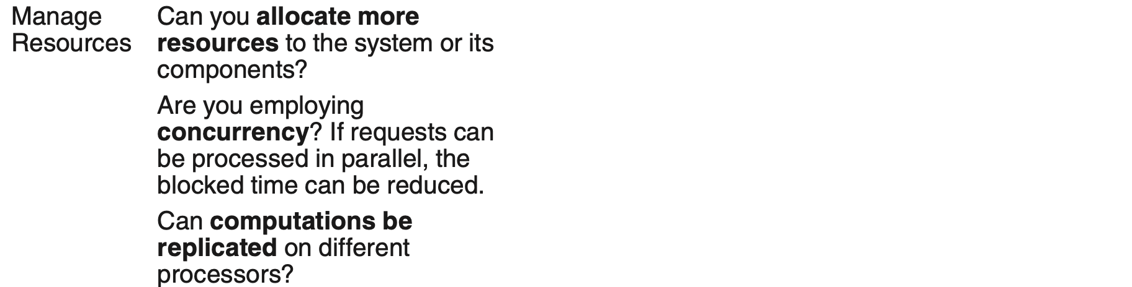
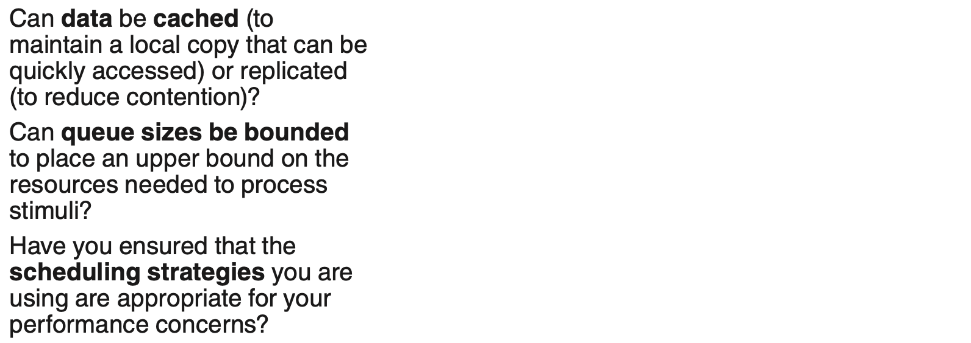
Tactics-Based Questionnaire for Performance

Slide 18
Service Mesh Pattern for Performance
The service mesh pattern is used in microservice architectures. The main feature is a sidecar—a proxy that accompanies each microservice which provides capabilities such as interservice communications, monitoring, and security.
A sidecar executes alongside each microservice and handles all interservice communication and coordination. They are deployed together, which cuts down on the latency due to networking, thereby boosting performance.

Slide 19
Service Mesh Pattern Benefits
Benefits:
Software to manage cross-cutting concerns can be purchased off the shelf or implemented by a specialist team that does nothing else, allowing developers of the business logic to focus on just that.
A service mesh enforces the deployment of utility functions onto the same processor as the services that use those utility functions. This cuts down on communication.
The service mesh can be configured to make communication dependent on context, thus simplifying functions such as the canary and A/B testing described in Chapter 3.

Slide 20
Service Mesh Pattern Tradeoffs
Tradeoffs:
The sidecars introduce more executing processes, and each of these will consume some processing power, adding to the system’s overhead.
A sidecar typically includes multiple functions, and not all of these will be needed in every service or every invocation of a service.

Slide 21
Load Balancer Pattern for Performance
A load balancer is a kind of intermediary that handles messages originating from some set of clients and determines which instance of a service should respond to those messages.
The load balancer serves as a single point of contact for incoming messages and farms out requests to a pool of providers that can respond to the request.
In this way, the load can be balanced across the pool of providers.

Slide 22
Load Balancer Pattern Benefits
Any failure of a server is invisible to clients (assuming there are still some remaining processing resources).
By sharing the load among several providers, latency can be kept lower and more predictable for clients.
It is relatively simple to add more resources to the pool available to the load balancer, and no client needs to be aware of this.

Slide 23
Load Balancer Pattern Tradeoffs
The load balancing algorithm must be very fast; otherwise, it may itself contribute to performance problems.
The load balancer is a potential bottleneck or single point of failure, so it is itself often replicated (and even load balanced).

Slide 24
Throttling Pattern for Performance
The throttling pattern is a packaging of the manage work requests tactic.
It is used to limit access to some important resource or service.
In this pattern, there is typically an intermediary—a throttler—that monitors (requests to) the service and determines whether an incoming request can be serviced.

Slide 25
Throttling Pattern Benefits
By throttling incoming requests, you can gracefully handle variations in demand.
In doing so, services never become overloaded; they can be kept in a performance “sweet spot” where they handle requests efficiently.

Slide 26
Throttling Pattern Tradeoffs
The throttling logic must be very fast; otherwise, it may itself contribute to performance problems.
If client demand regularly exceeds capacity, buffers will need to be very large, or there is a risk of losing requests.
This pattern can be difficult to add to an existing system where clients and servers are tightly coupled.

Slide 27
Map-Reduce Pattern for Performance
The map-reduce pattern efficiently performs a distributed and parallel sort of a large data set and provides a simple means for the programmer to specify the analysis to be done.
The map-reduce pattern has three parts:
a specialized infrastructure that takes care of allocating software to hardware nodes in a massively parallel computing environment and handles sorting the data.
a map function takes as input a key and a data set. It uses the key to hash the data into a set of buckets.
a reduce function. The number of reduce instances corresponds to the number of buckets output by the map function. The reduce phase does programmer-specified analysis and then emits the results of that analysis.

Slide 28
Map-Reduce Pattern Benefits
Extremely large, unsorted data sets can be efficiently analyzed through the exploitation of parallelism.
A failure of any instance has only a small impact on the processing, since map-reduce typically breaks large input datasets into many smaller ones for processing, allocating each to its own instance.

Slide 29
Map-Reduce Pattern Tradeoffs
If you do not have large data sets, the overhead incurred by the map-reduce pattern is not justified.
If you cannot divide your data set into similarly sized subsets, the advantages of parallelism are lost.
Operations that require multiple reduces are complex to orchestrate.

Slide 30
Summary
Performance is about the management of system resources in the face of particular types of demand to achieve acceptable timing behavior.
Performance can be measured in terms of throughput and latency for both interactive and embedded real time systems.
Performance can be improved by reducing demand or by managing resources more appropriately.

